Slide 1
Digital Portfolio
STUDENT NAME: NAZIYA SAMREEN.H
REGISTER NO AND NMID: 31224U09065
DEPARTMENT: BCA
COLLEGE: COLLEGE/ UNIVERSITY:
ISLAMIAH WOMEN'S ARTS AND SCIENCE COLLEGE

Slide 2
PROJECT TITLE
Creative portfolio

Slide 3


AGENDA
Problem Statement
Project Overview
End Users
Tools and Technologies
Portfolio design and Layout
Features and Functionality
Results and Screenshots
Conclusion
Github Link
3/21/2024 Annual Review

Slide 4

PROBLEM STATEMENT
“The challenge is to design and develop a portfolio that effectively showcases my skills, projects, and achievements in a visually appealing, user-friendly, and professional manner.”

Slide 5

PROJECT OVERVIEW
This project showcases my skills in web development, design, and problem-solving through the creation of a personal portfolio website. The portfolio highlights my academic background, technical expertise, and practical projects. It is designed to provide a professional online presence, demonstrating my ability to create responsive, user-friendly, and visually appealing websites.

Slide 6

WHO ARE THE END USERS?
The end user for a portfolio is the recruiter, employer, client, or evaluator who reviews it to assess skills, experience, and suitability.

Slide 7

TOOLS AND TECHNIQUES
Tools:
MS Word, PowerPoint, Google Docs/Slides (documentation & presentation)
Canva, Figma, Photoshop (designing)
HTML, CSS, JavaScript, GitHub (digital/web portfolio)
Platforms like LinkedIn, Behance, WordPress (online showcasing)

Slide 8
POTFOLIO DESIGN AND LAYOUT
1. Cover Page
Full name (large, centered)
Title/role (e.g., Student Portfolio, Graphic Designer, Software Developer)
A professional photo or logo
Minimal background (solid color, gradient, or abstract patte
8

Slide 9
FEATURES AND FUNCTIONALITY
The portfolio includes features like a home/intro page, about section, skills display, project showcase, resume download, and contact details. Its functionality ensures easy navigation, responsive design, interactivity, project filtering, and user engagement through accessibility and professional presentation.

Slide 10
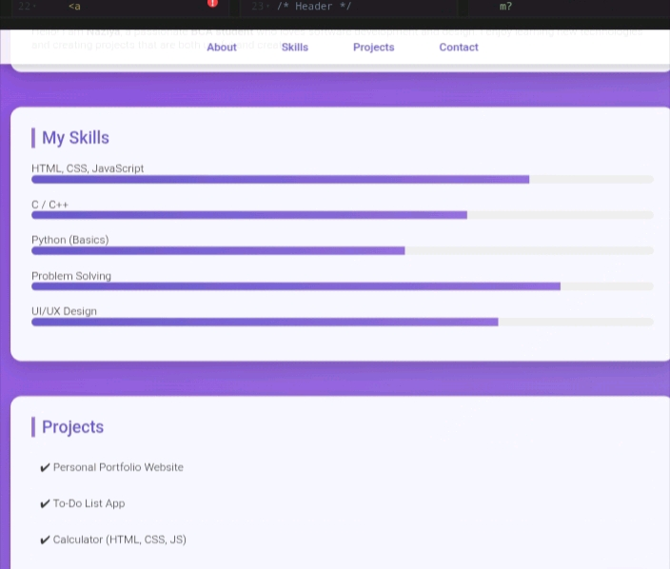

RESULTS AND SCREENSHOTS
3/21/2024 Annual Review
10

Slide 11
CONCLUSION
In conclusion, this portfolio highlights my skills, knowledge, and experiences while showcasing my ability to apply creativity and technical expertise effectively. It reflects my growth, dedication, and commitment to continuous learning and improvement. By presenting my projects and achievements, this portfolio not only demonstrates my capabilities but also serves as a foundation for future opportunities.
11

